Slide 1
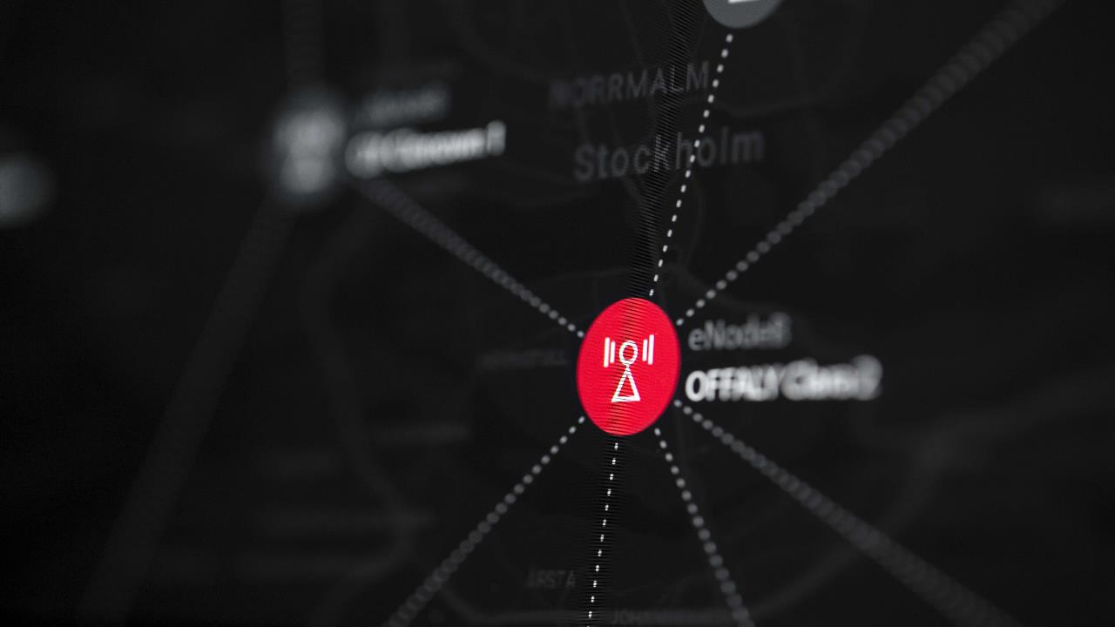
3UK 5G Ericsson WP6 Daily Performance Report
03/12/2021
Ericsson NPO

Slide 2



Summary
Data Availability:
5G (Ericsson)→ 03rd Nov till 07:00
Observations:
.
sgNB Addition SR has observed intermittent degraded from 20th November 19:00Hrs onwards. BRD345 is the top impacting site cause for Network degradation. Degraded for the Cell B102 intermittently. Captured Under #INC300000745318.
Avg DL User Throughput (Mbps ) has degraded from 20th November 03:00Hrs onwards. BHM620 is the top impacting site cause for Network degradation. Degraded for the cell BHM620(A101). Site is having Site having active critical & major External alarm. Captured under #INC300000744742
sgNB Addition SR has degraded from 24th 01:00hrs onwards, BRD324 and BRD329 is the top impacting site for the Network degradation. Majorly impacted on Cells-B102. Captured under #INC300000746838 . Again, started degraded on 25th early hours On BRD329 majorly impacted on Cells-B102 & C103 . Captured under #INC300000746667. Now trending normal.
Intra SgNB PSCell Change SR Has degraded from 23rd November 00:00Hrs, CDN181 and CDF244 are the top impacted intermittent degradation . Now back to normal trending.
Most of the KPI has degraded at 8PM on Wednesday as we had a football match between PSG Vs MAN City at Manchester after KPIs is in normal trend.
sgNB Addition SR has throughout NW , Top impacted site BRD331 since 27/11/2021 19:00-hrs, as checked the attempts slightly increased since degradation for A101 &B102 cell. Captured under #INC300000749663. Now trending normal.
3UK
Ongoing Analysis:
.
Intra SgNB PSCell Change SR Has degraded on 04:00Hrs on 30th November. Last ROP seems back to normal. Few of the site degraded at particular time. Later trending back to normal.

Slide 3
3UK 5G Network Level Performance Stats
SgNB Drop has degraded at 8PM on Wednesday as we had a football match between PSG Vs MAN City at Manchester after KPIs is in normal trend
sgNB Addition SR has degraded from 24th 01:00hrs onwards, BRD324 and BRD329 is the top impacting site for the Network degradation. Majorly impacted on Cells-B102. Captured under #INC300000746838 . Again, started degraded on 25th early hours On BRD329 majorly impacted on Cells-B102 & C103 . Captured under #INC300000746667. Now trending normal.
sgNB Addition SR has throughout NW , Top impacted site BRD331 #INC300000749663. Now trending normal
Trends produced by taking BIS ‘ed sites.

Slide 4
3UK 5G Network Level Performance Stats

Slide 5
Thank You

